Slide 1
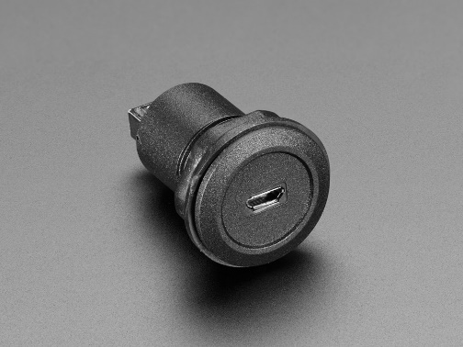

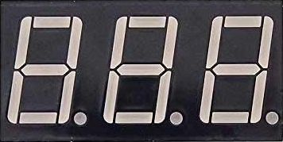
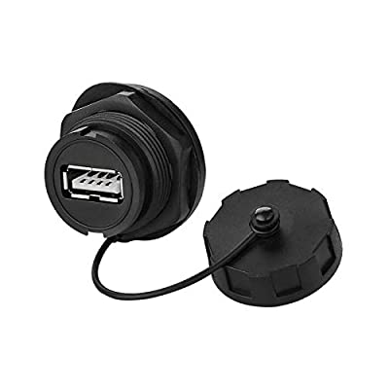
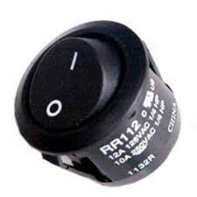
PANNEAU
1A 5x20mm Fuse IN
3 digits 7 segments display (+ bezel)
Socket µUSB B Charger 5V 1A
ON
Batterie faible
200mA 5x20mm Fuse OUT
Socket USB A
En charge
ON OFF
Charge OK

Slide 2
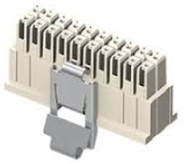
Connexions inter PANNEAU
+5V_IN
+5V_FUSED
+SEG_1
+5V_BOOST
+SEG_8
GND
CATH_DIG_2
RX
TX
CATH_DIG_1
CATH_DIG_3
+5V_BOOST_FUSED
CMD_LED_CHARGE_OK
VBAT_ON
CMD_LED_ON
CMD_LED_EN_CHARGE
CMD_LED_BAT_FAIBLE
VBAT
+5V_SUPPLY

